Slide 1

Installing Fonts
*** REMOVE THIS SLIDE BEFORE PRESENTING ***
STOP. This presentation uses fonts that are not included on Nimsoft or CA laptops. To make sure it presents correctly:
Open the Font-Museo.zip, pointed to below.
Unzip the fonts to a folder on your desktop.
Drag the files (not the folder) to c:\windows\fonts folder and they will install automatically.
You can also double-click on each font and click “install”
Close and re-open the PPT to have the fonts take effect.
YOU WILL ONLY NEED TO DO THIS ONE TIME PER COMPUTER
Double click me

Slide 2
Nimsoft Overview IT Management, as a Service
Quickly adopt and deploy essential IT Management for public and private infrastructure and services
Manoj Patel June 2012

Slide 3
Overview
Nimsoft Fast Facts
The Nimsoft Solutions
Nimsoft Monitor
Nimsoft Service Desk
Unified Management
Reference Stories
Q&A
Notes:
So, I’m going to pause here and tell you a little bit about Nimsoft.
We’ve been helping our customers manage internal and cloud-based infrastructure for over 10 years. The flexibility of our solution makes it easy to implement in pretty much any kind of environment. This flexibility also allows us to innovate quickly to help our customers manage, and embrace new technology safely.
<click>
Here you can see here a few examples of that… we were the first to provide:
Vblock and power monitoring
Usage Metering and billing – very helpful when trying to chargeback power or compute time in private clouds or multi-tenant scenarios
And all of this is available to our customers as either an on-premises or SaaS based solution.
Now, about a year ago, CA saw this momentum and decided to invest in our future – by acquiring us, and letting us run as a completely separate entity within CA. This investment has helped us ramp our engineering efforts. It has also allowed us to expand operations and provide local service to our customers all over the world.

Slide 4



AWARDs
Nimsoft has won the 2012 Information Age IT Services Innovation Award
http://www.mspalliance.com/2011/09/nimsoft-wins-mspalliance-mspworld-cup-award%e2%84%a2-2011/
Nimsoft Wins MSPAlliance MSPWorld Cup Award™ 2011
Recognized as Best in Show for Their Contributions to the Managed Services Industry
Nimsoft Wins “Best Place to Work Award”, Sponsored by San Francisco Business Times
http://www.nimsoft.com/archives/2404
Notes:
Now…there are other forces at play as well… (segue to SaaS dynamics slide)…

Slide 5
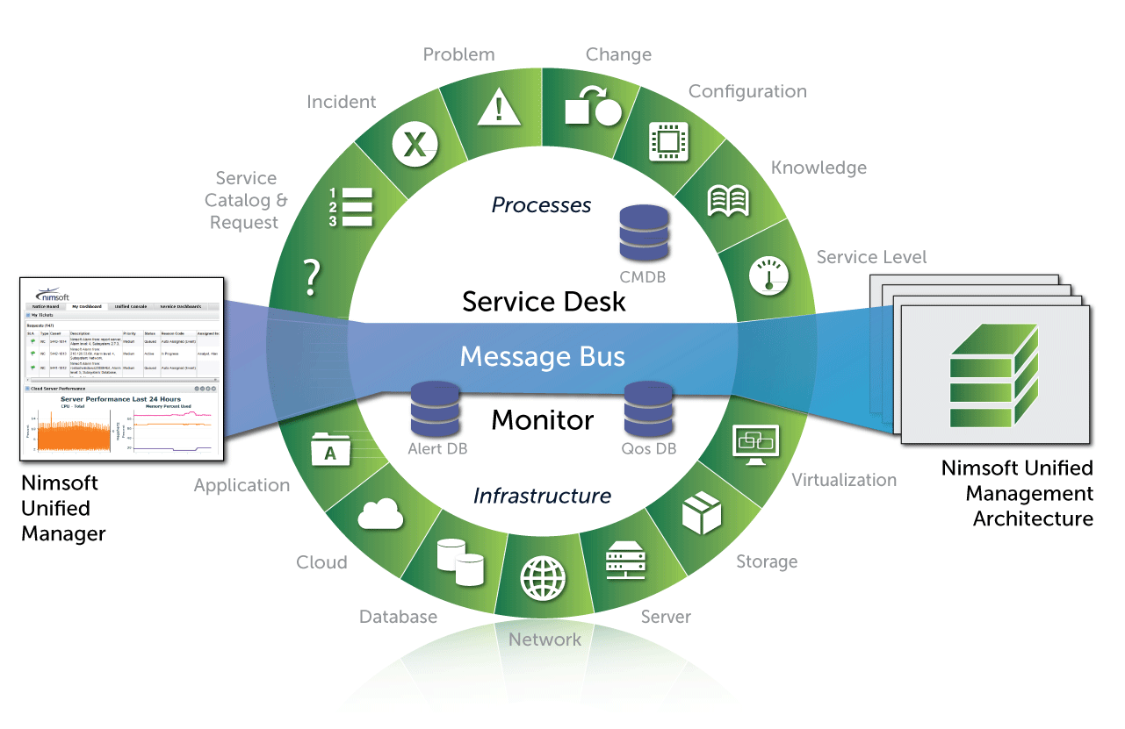
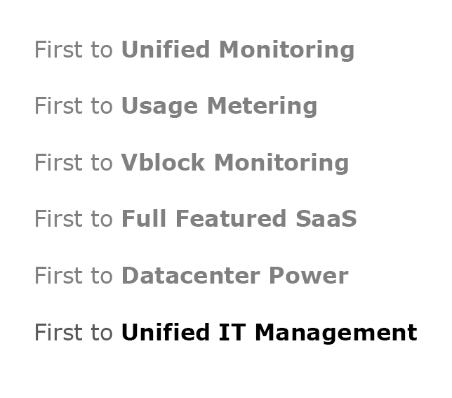
Nimsoft. Leading from the front.
The first to deliver a Unified Management™ solution across datacenter and cloud
Nimsoft Fast Facts
Founded in 1998
Acquired by CA in 2010
More than 1,000 customers in 36 countries; 450+ Service Providers
More than 20,000 end-user environments monitored by Nimsoft service provider customers
Direct offices in USA, UK, Spain, Norway, Germany, Sweden, Australia, Benelux, Singapore, India, Latin America
Headquartered in Campbell, California
Notes:
So, I’m going to pause here and tell you a little bit about Nimsoft.
We’ve been helping our customers manage internal and cloud-based infrastructure for over 10 years. The flexibility of our solution makes it easy to implement in pretty much any kind of environment. This flexibility also allows us to innovate quickly to help our customers manage, and embrace new technology safely.
<click>
Here you can see here a few examples of that… we were the first to provide:
Vblock and power monitoring
Usage Metering and billing – very helpful when trying to chargeback power or compute time in private clouds or multi-tenant scenarios
And all of this is available to our customers as either an on-premises or SaaS based solution.
Now, about a year ago, CA saw this momentum and decided to invest in our future – by acquiring us, and letting us run as a completely separate entity within CA. This investment has helped us ramp our engineering efforts. It has also allowed us to expand operations and provide local service to our customers all over the world.

Slide 6
What does Nimsoft do?
Nimsoft provides IT Management as a Service.
Nimsoft is a global leader in IT Management-as-a-Service. The company’s lightweight ITMaaS solutions make it easy for enterprises and service providers to implement comprehensive, adaptable monitoring and service desk capabilities essential for managing today’s dynamic computing environments.
Nimsoft provides unified, modern IT management solutions for more than 1000 enterprise and service provider customers globally, including COOP, BBS, Servecentric, 1&1, CDW, SoftLayer, Sur La Table, TriNet, and Virgin America. The company’s Nimsoft Unified Manager is an industry-leading solution which helps organizations easily monitor and manage IT services in increasingly complex business environments. Nimsoft products integrate with existing solutions at any point from the data center to the cloud, and are available on a pay-as-you-go basis.
Our unified solution provides visibility and control over your IT service delivery supply chain, allowing you to safely adopt new technology and exceed expectations.

Slide 7
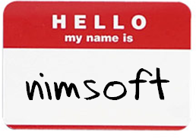













Nimsoft: “Essential IT Management” (External use)
Over 1000 customers
450+ leading Service Providers
20,000~ deployments
36+ countries around the world
Notes:
350 new logos in FY12, almost 80% YOY growth,
Examples: DB, 28000 devices monitored
Barclays, Autodesk SaaS and Corporate IT, Virtustream, Ace Hardware

Slide 8






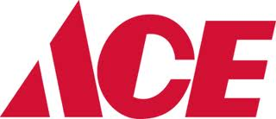
Nimsoft: “Essential IT Management” (Internal use)
Over 1000 customers
450+ leading Service Providers
20,000~ deployments
36+ countries around the world
Notes:
350 new logos in FY12, almost 80% YOY growth,
Examples: DB, 28000 devices monitored
Barclays, Autodesk SaaS and Corporate IT, Virtustream, Ace Hardware

Slide 9
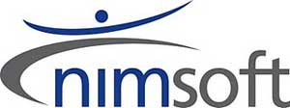

extensible
open
unified
mobile
social
collaborative
Innovation
upgradeable
Operational Excellence
SaaS
modern user experience
multi-tenant
Notes:
The next couple of slides set up our philosophy/differentiation on the products and what we are all about

Slide 10
Unified. Not just integrated.
Integrated
Brittle point-to-point integration prone to breaking during upgrades
Gaps multi-vendor architecture means no single overall vision
Disjointed hopping from product-to-product means reduced productivity and lost context
Unified
Fluid message bus allows stability during additions or upgrades
Comprehensive single vision ensures products evolve in-step
Holistic views of service desk and monitoring streamlines workflows

Slide 11
The Nimsoft Solution
Nimsoft ITMaaS Architecture and Shared Services
Desktop | Web | Tablet | Mobile | API | SDK
Nimsoft Monitor
Nimsoft Service Desk
UNIFIED IT MANAGEMENT
Cloud and On Premise | Multi-Tenant | Collaboration | API | SDK

Slide 12
Channels:
Blogs & Online
Broadcast
Business media
Tech trades
Sector trades
Pains:
Adoption of new technologies to compete
The security of sensitive customer or commercial data
Dramatic changes in IT
Loss of confidence in the global economy
Desired Outcomes:
Deliver responsive, profitable per-tenant service and services.
Optimize the IT supply chain through better management.
Spend less. Get results. Sooner.

Slide 13

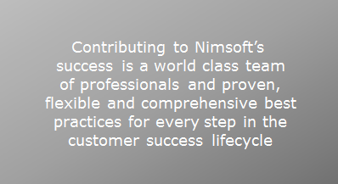
Deployment Options
Flexibility to suit your business.
 | SaaS | On-premises
Complete Service Desk and Monitoring functionality | X | X
No upfront management hardware costs; Accelerated ROI | X
Reduced training and management overhead | X
99.9% guaranteed availability | X
Hardened, certified infrastructure | X
Access to Nimsoft operational expertise | X | X
Control and customize the Nimsoft management server; Easily resell to customers |  | X
Control the physical location of data for policy, security or compliance reasons |  | X
Support remote sites with poor Internet performance |  | X
Notes:
SAAS Customers install robots, probes and a local relay to communicate to our highly-available and secure hosting environment

Slide 14
Why Nimsoft?
Unified. Not integrated
Monitoring and service management in a simple, scalable solution
Easy to implement and extend
Get to value more quickly in the most demanding environments.
Easy to configure and operate
You handle what’s core.
We’ll handle what’s chore.
Easy to buy and resell
Deliver multi-tenant management of personalized IT services
Notes:
Rapid adoption is from the initial implementation and CUSTOMER (tenant) implementation as well. HCL example – “ I can provision customers more quickly”

Slide 15
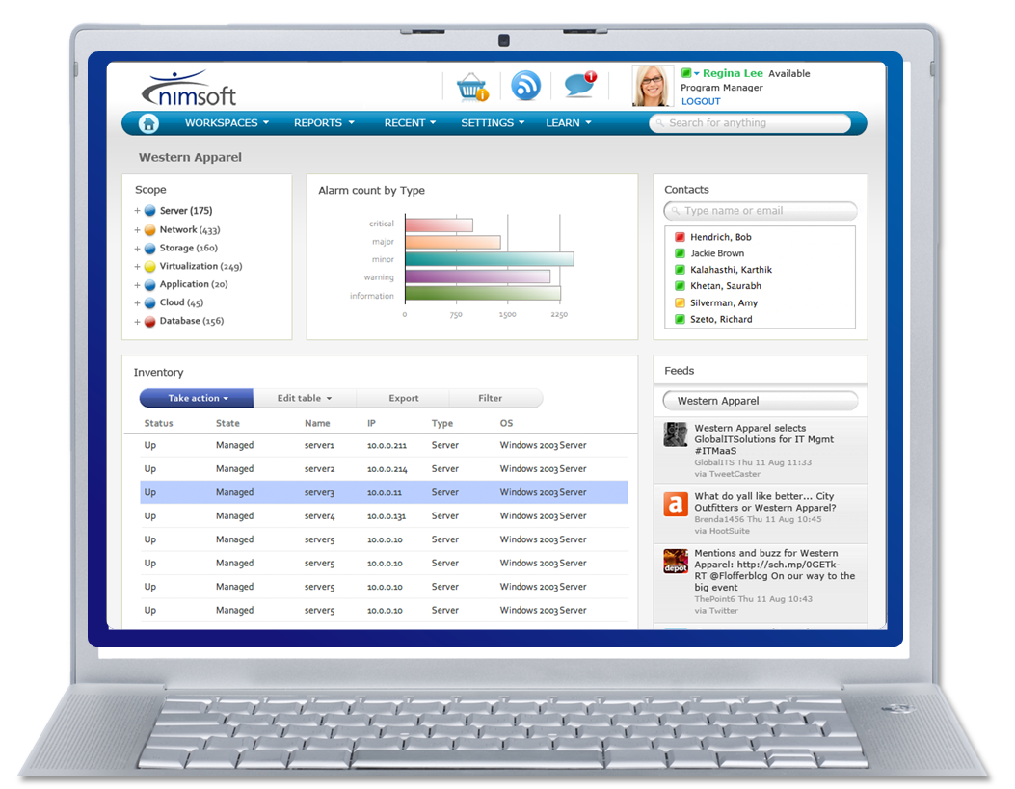
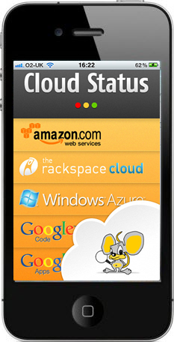







Nimsoft: manage complexity with confidence
IT Management as a Service
Unified. Ubiquitous.
Monitor and Service Desk. Now available anywhere.
Cloud-ready.
Agent-optional; easily deployed on-premises or in the Cloud.
Multi-tenant.
Scale easily to provide every client a personalized view.
Easy. Extensible.
Simple point & click configuration. Command line & APIs available.
Usage-based.
Self-service; meter and charge for resources consumed.
Social.
Access crowd-sourced knowledge and best practices.
Notes:
Easy
Configurable
Contextual
Fast
Collaborative
Social

Slide 16




PART I
Q&A
Socialize with us:

Slide 17
MONITOR
Monitor Business IT Services from the Datacenter to the Cloud

Slide 18








Broad Monitoring Coverage
Apache HTTP FlexPod IBM DB2 Linux/Unix Citrix XenApp
Citrix XenServer IBM Power Systems Routers and Switches
vCloud Oracle Microsoft SQL Server
Vblock Oracle WebLogic
Cisco VOIP Microsoft Windows Server Sybase Jboss SNMP RCA and Topology Maps DCIM/EcoMeter Microsoft IIS
Cisco IP SLA IBM Lotus Notes VMWare
EMC Microsoft Lync
Cisco UCS Microsoft Hyper-V Cisco QoS
NetApp Apache Tomcat Microsoft Active Directory
Microsoft Sharepoint Microsoft Exchange IBM WebSphere
Oracle Solaris Zones IBM PowerVM
SAP vCloud Novell Informix MySQL
Private Cloud Monitoring Public Cloud Monitoring Private Cloud Monitoring Datacenter Monitoring
Public Cloud Monitoring
Datacenter Monitoring
Nimsoft Monitor
vCloud Citrix XenServer Oracle Solaris Zones
Application
Apache HTTP FlexPod IBM DB2 Linux/Unix Citrix XenApp
Citrix XenServer IBM Power Systems Routers and Switches
vCloud Oracle Microsoft SQL Server
Vblock Oracle WebLogic
Cisco VOIP
Microsoft Windows Server Sybase
Jboss SNMP RCA and Topology Maps DCIM/EcoMeter Microsoft IIS
Cisco IP SLA IBM Lotus Notes VMWare
EMC Microsoft Lync
Cisco UCS Microsoft Hyper-V Cisco QoS
NetApp Apache Tomcat Microsoft Active Directory
Microsoft Sharepoint Microsoft Exchange IBM WebSphere
Oracle Solaris Zones IBM PowerVM
SAP vCloud Novell Informix MySQL
Cloud User Experience
Cloud and Virtual
Database
Storage
Power and Cooling
Server
Network
IBM PowerVM Microsoft Hyper-V VMWare
Notes:
130 probes

Slide 19
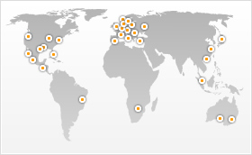

User Experience Monitoring
SaaS solution for monitoring global Cloud application health
Completely customizable to your brand
IPv6 and IPv4 enabled
60+ locations in 40 countries.
Self-service and deploys in less than 10 minutes
Rich Alerting, Dashboards and root cause analysis
Alerting via text, pagers, phone, twitter, IM and more.
600-plus customers including Wikimedia, Virgin, America, Twitter, Zappos, and Wordpress.

Slide 20
Watchmouse End User Monitoring
Global monitoring outside the firewall of:
Web Transaction Monitoring
Synthetic user scripts (protocol level)
Multi-step / multi-locations
Record/replay
Conversion tool for HP LoadRunner/Business Process Monitor/RUM scripts)
Real User Browser Monitoring
Synthetic user scripts (ajax, JavaScript etc. running in the browser)
Captures browser render time to provide a true depiction of the end user experience
Mobile Application Monitoring (new!)
API and Web Service Monitoring
REST, SOAP, oAuth, JSON, XML, RSS feeds, openID and XML-RPC.
Network Protocols
HTTP(S), DNS, FTP(S), LDAP(S), IMAP, SMTP, SFTP, TFTP, SCP, SIP & XMPP
Vulnerability Scanning (using Nesus)

Slide 21
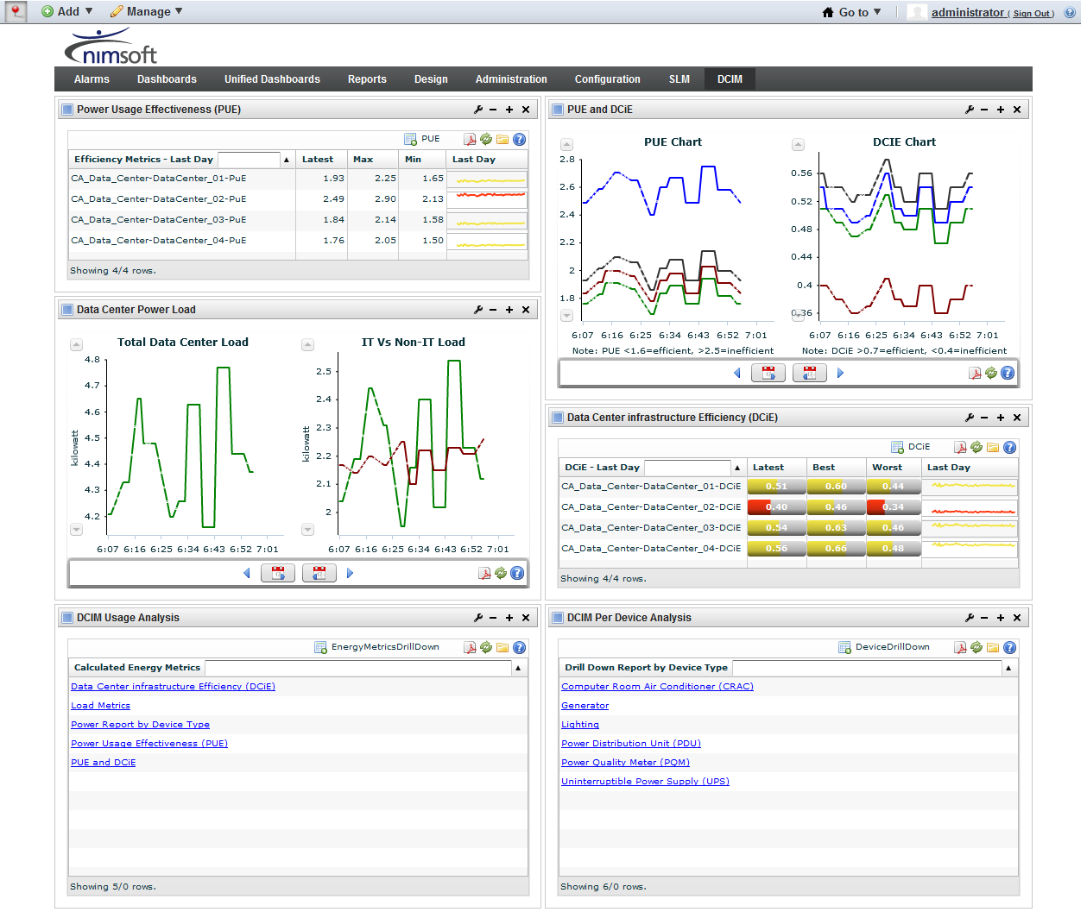
Nimsoft DCIM
Extends monitoring functionality to energy and environmental consumption and tracking
Integrated with ITMaaS – Nimsoft Datacenter/Cloud Monitoring and Service Management
Based on leading CA ecoMeter product

Slide 22
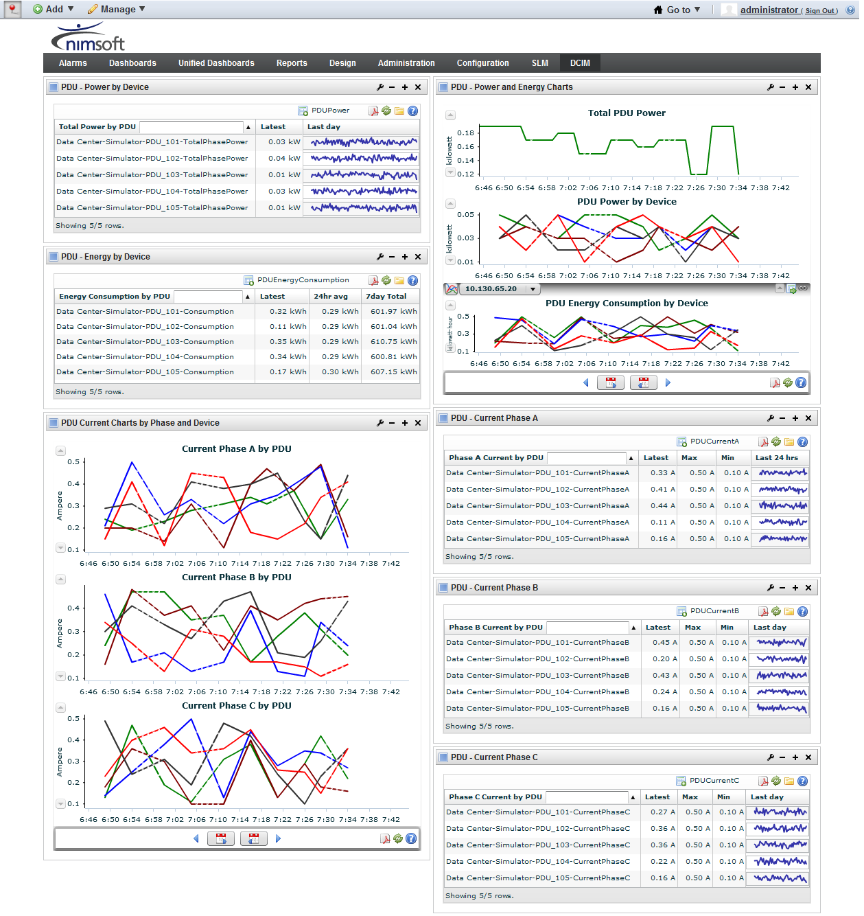
What does Nimsoft DCIM deliver?
Graphical representation of power usage effectiveness (PUE), DCiE, total IT load, total non IT load and many more key performance indicators.
Real time alerting + performance monitoring for common device types
Insights into energy optimization within the data center
Chargeback/Showback reporting for cost analysis
Packaged as a single Nimsoft probe – easy to download and go!
Notes:
Dan to play with this.

Slide 23
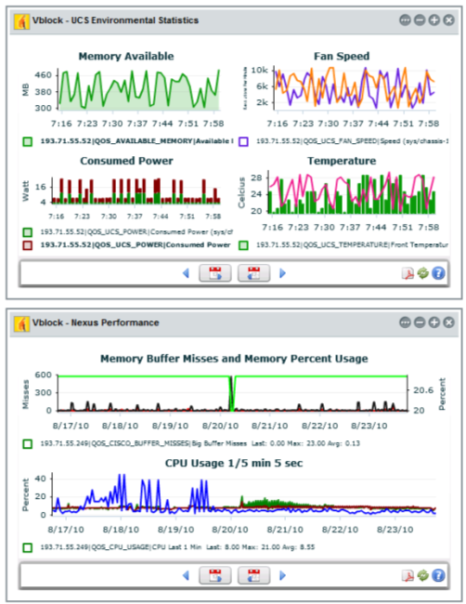
Performance Management DB (PMDB)
Spot trends before they become problems.
Historical performance data provides a new perspective on infrastructure performance
Use it to spot trends and prevent problems from occurring and proactively manage service levels

Slide 24
ARC, USA
“We have great visibility with Nimsoft Monitor and can view system performance metrics that help us determine the cause of issues or potential problems quickly."
—Michael Tarajos, CAS Application Engineer for ARC’s Tampa Production Support Team
Notes:
Now…there are other forces at play as well… (segue to SaaS dynamics slide)…

Slide 25
Nimsoft Monitors
Application
Track KPI’s for all your business applications to ensure they continue to perform optimally.
Cloud
Monitor public and private clouds, including SaaS, PaaS, and IaaS to report on, and maintain SLAs.
Database
Monitor databases, associated applications, and user transactions to ensure high throughput and peak performance.
Network
Complete network visibility allows you to maintain the highest levels of business service quality.

Slide 26
data center energy management needs to improve…
2.5 % US energy consumption is from data centers
98% energy costs
Uptime and availability require reliable power and cooling
20-40%
energy lost before it gets to server
5-6 Years for DC power demand to double
Notes:
Great slide. Use this early.
Powering data centers costs serious money.
Downtime from overheated servers costs serious money.
IT can’t effectively manage spikes or failures of power and cooling.
Power and cooling units often are poorly designed and energy-wasteful, leading to hidden and avoidable expenses.
Datacenter Infrastructure Management (DCIM) software and services to allow planning, management and optimization for performance, space, power and cooling within the datacenter.

Slide 27
Nimsoft Monitors
Cloud User Experience Monitoring (Watchmouse)
SaaS solution for monitoring global Cloud application health
Web Transaction Monitoring
SMobile Application Monitoring (new!)
DCIM (Datacenter Infrastructure Management)
Extends monitoring functionality to energy and environmental consumption and tracking
Integrated with ITMaaS – Nimsoft Datacenter/Cloud Monitoring and Service Management
Insights into energy optimization within the data center

Slide 28
Nimsoft Monitors
Server
Optimize the performance of servers—and the business services they support—all day, every day.
Storage
Monitor and optimize the utilization of scarce storage resources.
Virtualization
Alerts, trending information, and real-time intelligence helps prevent problems when tapping into the performance, agility, and cost benefits of virtualization.

Slide 29

Wikimedia
“Historically, we have been using
our own deployed monitoring services to alert us of any issues with our services and infrastructure. With WatchMouse, we now have
a more complete solution.”
—CT Woo
Director of Technical Operations Wikimedia
Notes:
Now…there are other forces at play as well… (segue to SaaS dynamics slide)…

Slide 30
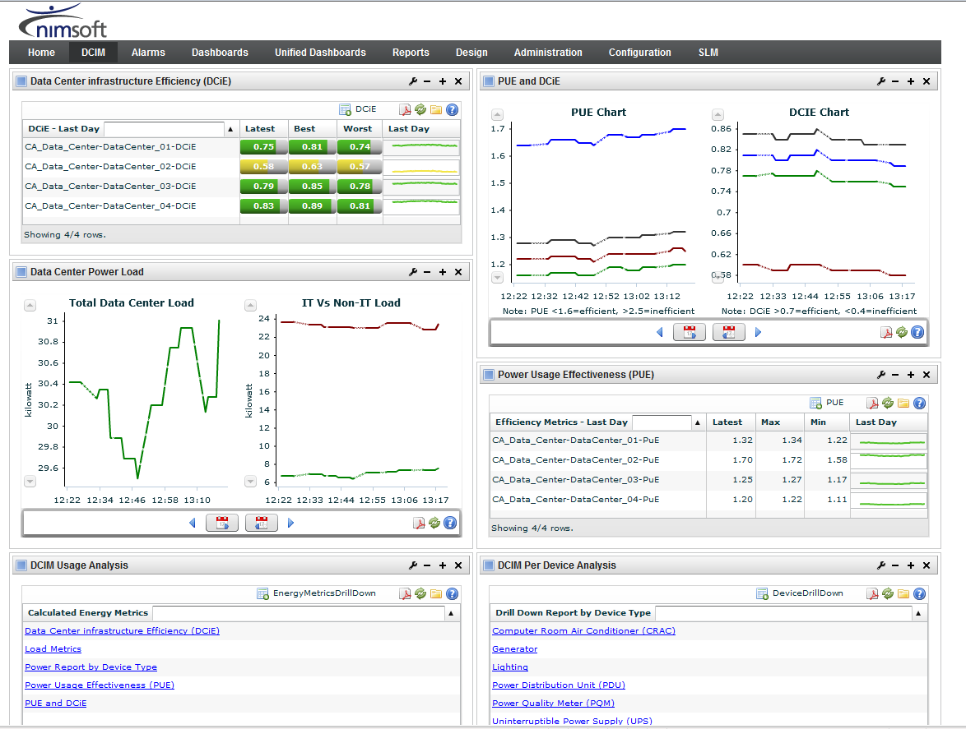
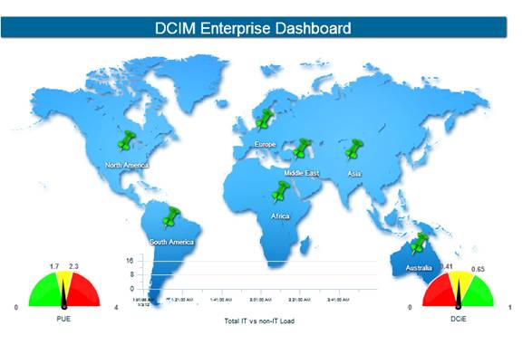
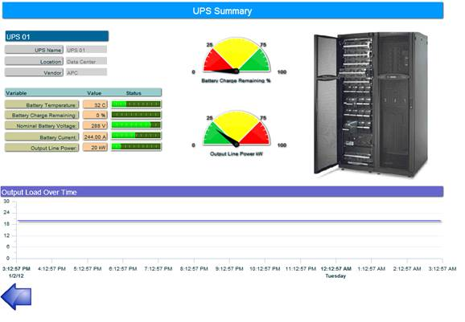
Dashboards and performance reporting

Slide 31

Multi-tenant
Scale your services—efficiently and economically.
Scale services economically to support 1 customer, or 100.
Personalize services with a custom, private view of managed environments…
…while you get a consolidated view of all environments in a single pane of glass.

Slide 32
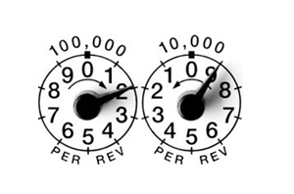
Usage metering and billing
Provide pay-as-you-grow scalability for your customers.
Provides detailed (hourly) usage data on Nimsoft probes and infrastructure usage
Allows flexible billing for “elastic” environments
Enables xSPs to build unique pricing and service models

Slide 33

The Nimsoft Web Archive
Access the world’s largest collection of monitoring probes.
Contains monitoring solutions to cover practically everything you’ll find inside—and outside—of your data center
One-click downloads additional functionality, anytime
Easy updates/upgrades
150+ probes available

Slide 34
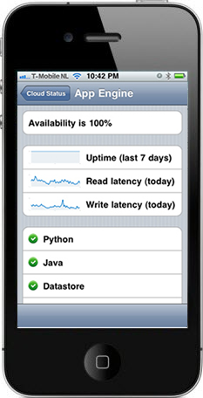
Nimsoft for iOS
A unified view, now in your pocket.
Manage alarms and performance information from any Apple iPhone or other iOS device.
“Anywhere” access accelerates problem acknowledgement, assignment, investigation and resolution.
Available as a FREE download from the Apple App store. Download now >

Slide 35

Flexible Pricing & Licensing
Works with your budget, and your business.
Pioneering easy to consume subscription based pricing to help xSP customers to align costs with revenue
Variety of other low-risk, flexible licensing and pricing models (subscription and perpetual) available

Slide 36
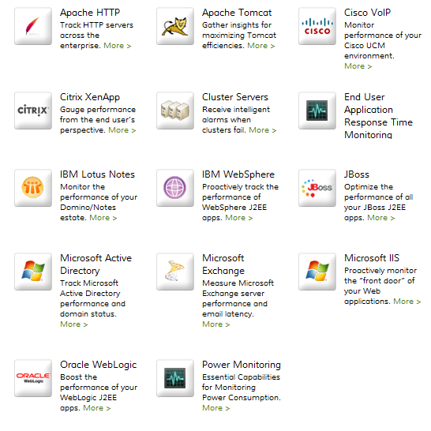
Nimsoft Monitor for Application
Track KPI’s for all your business applications to ensure they continue to perform optimally.
Benefits
Identify application problems before users are impacted
Deep visibility into application specific metrics helps determine root cause and accelerate resolution
“High-end capability” not available in many other solutions
Synthetic and Real-User monitoring available

Slide 37

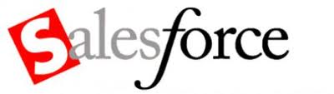

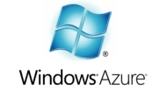


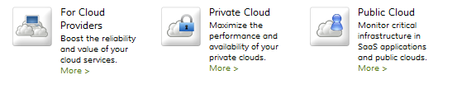
Nimsoft Monitor for Cloud
Monitor public and private clouds, including SaaS, PaaS, and IaaS to report on, and maintain SLAs.
Purpose-built monitoring for:
Amazon EC2 and S3 Web Services
The Rackspace Cloud
Microsoft Azure
Google App Engine
Google Apps
Salesforce CRM

Slide 38
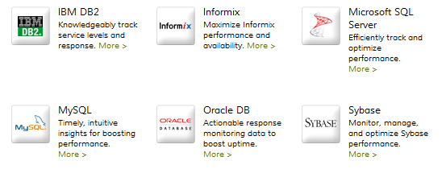
Nimsoft Monitor for Database
Monitor databases, associated applications, and user transactions to ensure high throughput and peak performance.
Benefits
Improve performance and uptime.
Accelerate identification of performance issues.
Reduce monitoring administration cost and effort.
Optimize database infrastructure/usage.

Slide 39
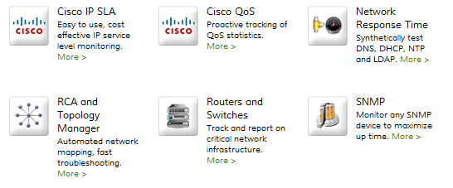
Nimsoft Monitor for Network
Complete network visibility allows you to maintain the highest levels of business service quality.
Benefits:
Visualize topology & pinpoint the root cause for bottlenecks.
Monitor VOIP infrastructure to ensure high call quality.
Actively test critical network services such as DNS, DHCP…
Alert on performance degradation to pre-empt user impact.

Slide 40
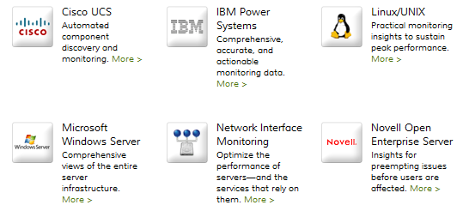
Nimsoft Monitor for Server
Optimize the performance of servers—and the business services they support—all day, every day.
Benefits
Automates daily checks on server KPIs
Information gathered includes:
Disk space, services, processes, Windows Event Logs
Monitors availability and health of hypervisors and basic performance of virtual machines
Supports FlexPod and Vblock

Slide 41
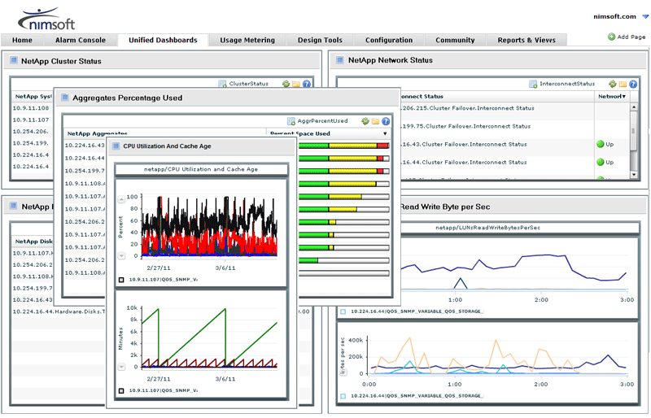

Nimsoft Monitor for Storage
Monitor and optimize the utilization of scarce storage resources.
Benefits
Correlate storage usage with environments, users and applications
Prevents downtime and improve SLA compliance for applications running in storage
Streamline storage administration with a single tool for EMC, NetApp and local storage environments.

Slide 42
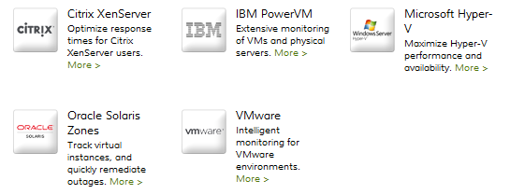
Nimsoft Monitor for Virtualization
Alerts, trending information, and real-time intelligence helps prevent problems when tapping into the performance, agility, and cost benefits of virtualization.
Benefits:
Maximize utilization / value of physical and virtual resources.
Reduce administrative effort and costs.
Prevent downtime and improve SLA compliance.
Automatically correlate physical and virtual resources.

Slide 43

MTI, EMEA
“It would not be an exaggeration to
say that, without Nimsoft Monitor, we would not have been able to offer our MTI Care service in the first place. Nimsoft Monitor is also playing a pivotal role in the delivery and fulfillment of our new MTI Cloud solution.”
—Richard Flanders
Director of Product Marketing MTI
Notes:
Now…there are other forces at play as well… (segue to SaaS dynamics slide)…

Slide 44

Servecentric, Ireland
“We rely on Nimsoft Monitor as our first line of defense. It helps us quickly identify, troubleshoot and resolve client infrastructure
issues, and even prevent issues from happening in the first place.”
—Eddie Lyons
Operations Director
Servecentric
Notes:
Now…there are other forces at play as well… (segue to SaaS dynamics slide)…

Slide 45
SERVICE MGT
The Service Desk is the only IT asset of your users

Slide 46
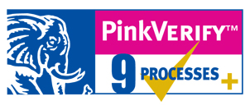
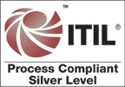
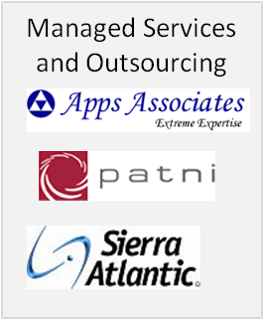
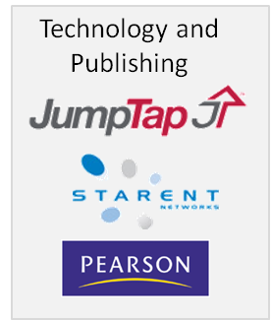


Best Practices and Experience
Service Operations
Incident Management
Problem Management
Request Management
Event Management
Service Transition
Change Management
Service Asset Configuration Management
Knowledge Management
Service Design
Service Level Management
Availability Management
Years of experience built in
Designed and built by a Service Provider
Ability to start with standard configurations pre-loaded
Notes:
AVM = Availability Management PM = Problem ManagementCAP = Capacity Management REL = Release & Deployment ManagementCHG = Change ManagementRF = Request FulfillmentEV = Event ManagementSACM = Service Asset & Configuration ManagementFM = Financial ManagementSCM = Service Catalog ManagementIM = Incident ManagementSLM = Service Level ManagementITSCM = IT Service Continuity ManagementSPM = Service Portfolio ManagementKM = Knowledge Management

Slide 47
Best Practices and Experience
Service Operations
Incident Management
Problem Management
Request Management
Event Management
Service Transition
Change Management
Service Asset Configuration Management
Knowledge Management
Service Design
Service Level Management
Availability Management
Nimsoft Service Desk
Notes:
AVM = Availability Management PM = Problem ManagementCAP = Capacity Management REL = Release & Deployment ManagementCHG = Change ManagementRF = Request FulfillmentEV = Event ManagementSACM = Service Asset & Configuration ManagementFM = Financial ManagementSCM = Service Catalog ManagementIM = Incident ManagementSLM = Service Level ManagementITSCM = IT Service Continuity ManagementSPM = Service Portfolio ManagementKM = Knowledge Management

Slide 48








Prescriptive Service Management
Nimsoft Service Desk
Incident
Knowledge
Problem
Catalog
Change
Request
Service Level
Configuration

Slide 49

Apps Associates, EMEA
“Nimsoft Service Desk enables us to respond more quickly to client requests and utilize email as well as Web-based communications to provide prompt, personalized service to multiple clients,”. We now have a robust MSP-ready solution that will grow with us, support our ITIL adoption efforts, and help us proactively manage SLAs and customer satisfaction.”
-Thiru Sadagopan, Director of Infrastructure Managed Services at Apps Associates
Notes:
Now…there are other forces at play as well… (segue to SaaS dynamics slide)…

Slide 50
Nimsoft Service Desk
Incident Management
Pre-packaged workflows make it easy to identify, register, prioritize, categorize, and track incidents reported to your service desk
Problem Management
Identify chronic service issues and prevent recurrences to eliminate the impact of these issues on the business
Change Management
Evaluate, prioritize, plan, test, document, and implement change requests using ITIL compatible best practices
Confiuration Management
A consolidated and actionable view of devices, relationships, requests, alarms, incidents, problems, known errors, changes, and releases

Slide 51
Nimsoft Service Desk
CMDB
Manage configuration items (CI’s/Service Assets)
Knowledge Management
Improve the quality of decision making with using optimal, and vetted, information to resolve service issues
Service Catalog & Request Management
Empowers end users to help themselves, and provides an easy way for them to submit requests for services
SLM
Set, meet, and exceed your SLAs

Slide 52

Nimsoft Service Desk Incident Management
Pre-packaged workflows make it easy to identify, register, prioritize, categorize, and track incidents reported to your service desk.
Benefits:
Tight integration with Knowledge Management to increase efficiency and lower mean time to resolution
Prebuilt incident templates ensure accurate information is collected to increase 1st contact resolution
Flexible workflow to increase response efficiency and quality

Slide 53

Nimsoft Service Desk Problem Management
Identify chronic service issues and prevent recurrences to eliminate the impact of these issues on the business.
Benefits:
Identify chronic issues which impact business services
Link multiple incidents to a single problem to efficiently solve, and close, any related incidents
Capture workarounds, solutions, or known-error information in the Knowledge Management to streamline future efforts

Slide 54

Nimsoft Service Desk Change Management
Evaluate, prioritize, plan, test, document, and implement change requests using ITIL compatible best practices.
Benefits:
Leverage standardized change procedures to meet objectives for SOX, PCI, and other compliance requirements
Automatically identify assets/CI’s and services which might be affected to minimize service impact
Change calendar and automatic notifications of all change stakeholders to provide transparency and mitigate risk

Slide 55

Configuration Management DB (CMDB)
Manage configuration items (CI’s)
ITIL v3 compliant repository for IT configuration items.
Consolidated and actionable view of devices, relationships, requests, alarms, incidents, problems, known errors, changes, and releases.
Allows consistent, reliable, effective, and efficient service delivery

Slide 56
Nimsoft Service Desk Configuration Management
A consolidated and actionable view of devices, relationships, requests, alarms, incidents, problems, known errors, changes, and releases.
Benefits:
Define and manage relationships and dependencies to diagnosis problems and plan changes more effectively
Associate affected groups with changes and outages to improve quality of service
Track history to show configuration drift and aid in capacity and trend analysis

Slide 57

Nimsoft Service Desk Knowledge Management
Improve the quality of decision making with using optimal, and vetted, information to resolve service issues.
Benefits:
Access proven experience and information to resolve service issues more quickly and consistently
Easily retrieve workarounds, solutions, or known-error information to streamline future efforts
Giving technicians and end users easy access to the knowledge base to improve service levels.

Slide 58
Nimsoft Service Desk Service Catalog & Request
Empowers end users to help themselves, and provides an easy way for them to submit requests for services.
Benefits:
Automated intake & routing to reduces costs
Optimized request handling to increase efficiency
More timely, accurate end-user communication to increase overall satisfaction

Slide 59
COOP, Norway
“With Nimsoft, we finally gain control over the critical IT services that drive our business. Now we identify potential problems before division and store managers are even aware of them. With Nimsoft, we are able to deliver more complex, higher quality services to a growing population with the same level of resources,”
- Per Haakon Vestby,
head of IT Department at COOP Norge Handel
Notes:
Now…there are other forces at play as well… (segue to SaaS dynamics slide)…

Slide 60

ATRION, USA
"Nimsoft allows us to do more without spending more. Now we’ll be able to monitor from an application, rather than a device, standpoint, which opens up a host of new possibilities in terms of service offerings. Plus, not only can we expand our service catalog, we can offer higher value, higher margin services—all with one tool set."
—Tim Hebert, CEO, Atrion
Notes:
Now…there are other forces at play as well… (segue to SaaS dynamics slide)…

Slide 61

Service Level Management
Set, meet, and exceed your SLAs.
Allows setting of realistic SLAs
Helps proactively manage and exceed SLAs
Provides coordinated, effective responses to service requests or incidents to help you meet or exceed SLAs and increase customer satisfaction.

Slide 62

AXSOS, GERMANY
“With Nimsoft, we will have more
transparency, especially for SLA
management, which results in
increased trust and credibility
with our customers.”
—Frank Müller
CEO
AXSOS
Notes:
Now…there are other forces at play as well… (segue to SaaS dynamics slide)…

Slide 63
BBS, Norway
“With Nimsoft, we have been able to measure and report on SLAs easily, make proactive error corrections and reduce the number of incidents we experience—all of which has led to improved service and application availability for our end users.”
—Frank Bredo Remen, Team Manager in IT Operations, BBS
Notes:
Now…there are other forces at play as well… (segue to SaaS dynamics slide)…

Slide 64

Gateways
Integrate all of your IT management tools with ease.
Nimsoft Gateways help translate alarm messages into other formats, including:
SNMP: Simple Network Management Protocol
SMTP: Simple Mail Transport Protocol (“email”)
Predefined Gateways available for:
Remedy, ServiceNow, SalesForce.com
Other 3rd party frameworks
Bi-directional gateways allow third-party tools to close alarms in the Alarm console

Slide 65

Self Service Portal
Empower your users, accelerate service.
One-stop-shop gives end-users the ability to log requests and track progress in real time.
Guides authorized users through common requests that are relevant to them.
It also allows the end user to search a knowledge base for known solutions to resolve issue(s).

Slide 66
Benefits for your users
Workflow focuses on actions
Tell Nimsoft Service Desk what to do, don’t guess based on status changes
True Interface for Service Desk Agents
High Throughput, Multi-Window design
Keep individual Incidents, Change Requests, etc. open while working in other parts of the system
Easy to use Portal Web Interface
Available anywhere anytime
Self Service available by web or e-mail
Automatic incident creation lets you proactively address potential service interruptions

Slide 67
Benefits for your users
Simple implementation shortens your time to value
Seamless upgrades - get the latest improvements without ripping apart your implementation
Real world proven ITIL and years of best practices built in
Adaptable workﬂow allows you to meet your speciﬁc business needs without custom code

Slide 68
Benefits for your Organization
Configure don’t code
Workflow is 100% configurable
No programming skills required
Configuration not lost in upgrades
Low cost of ownership
Transparent upgrades
Cost Savings
Automated free upgrades
No infrastructure required
All modules in one
Simple Pricing Model
Pay per user
Fixed or floating licenses
Free end user access

Slide 69
Unified IT Management
from the data center to the cloud

Slide 70
Unified IT Management from the data center to the cloud
Single, extensible solution
Unified experience
Nimsoft Monitor
Nimsoft Service Desk
Modern IT
Perfect for Service Providers and Emerging Enterprises
Available on-demand or on-premise
IT Management-as-a-Service
Notes:
For Whom: Internal and external IT service providers who need to embrace established, emerging and future technology while optimizing service quality
Product Category : Nimsoft Unified Manager is an IT Management Solution
Benefits:
Lowers TCO through consolidation and economies of scale
Reduces risk by enabling safe, pragmatic and rapid adoption of new technologies
Competition and Differentiation: Unlike IT management suites or collections of point products, Nimsoft Unified Manager is a single unified monitoring and service management offering that supports the broadest set of technologies in a multi-tenant future-ready architecture
Deliver a unified solution that extends easily to meet our customer’s IT management needs
Single solution to multiple IT management problems
Single infrastructure
Modular, common infrastructure
Extended discovery and automation
Service provider ready
Multi-tenant, multi-site architecture
Flexible business models
Ready to meet critical needs
Reduce service delivery costs and align to business
Fast time to value
Natively ready for new technology challenges – virtualization, cloud and beyond

Slide 71
Nimsoft Service Desk & Monitor Key components of Nimsoft Unified Manager

Slide 72
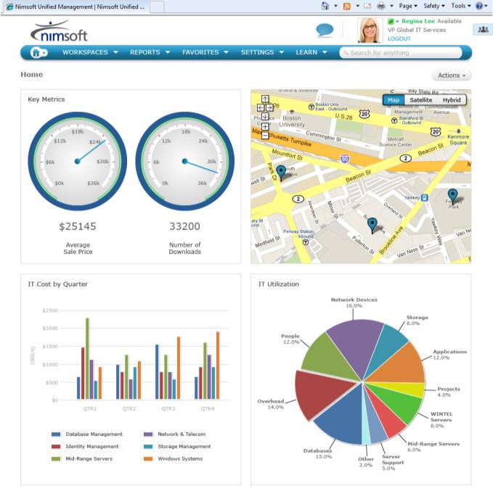
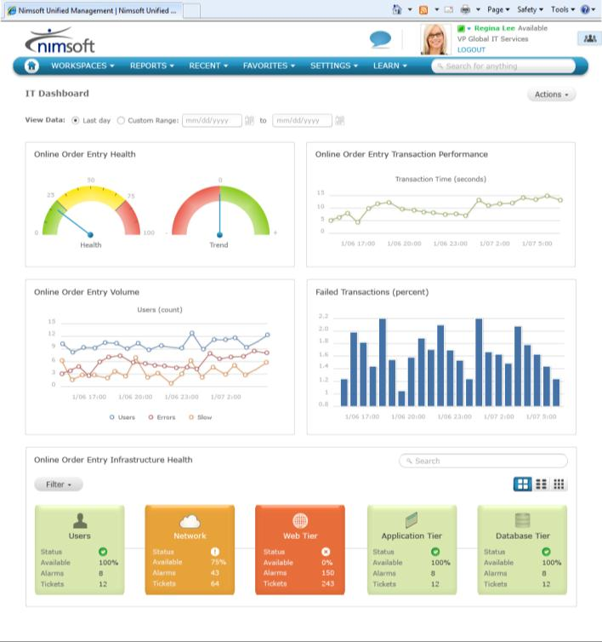
Unified Views
Executive Views
IT Views
Real-Time or historical metrics
Web 2.0 contextual mash-up
Configurable charts, metrics and time
Multi-level drill-down

Slide 73
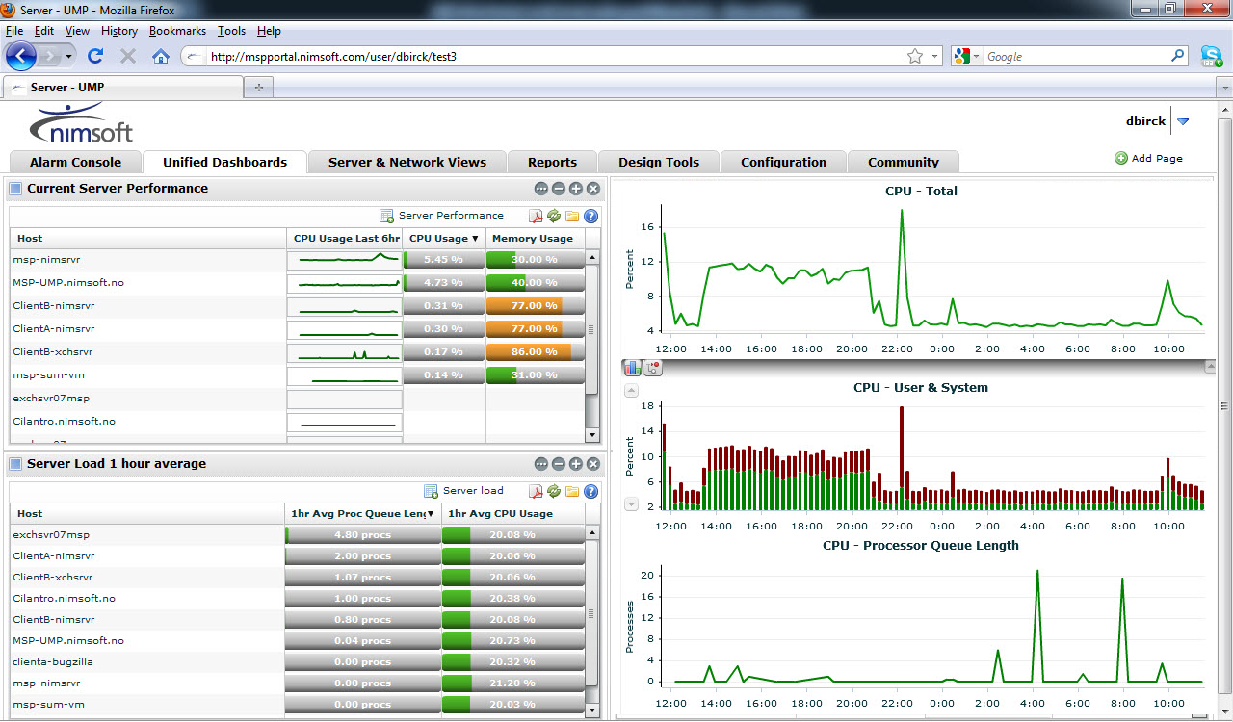
Unified Management Portal
A Powerful, Flexible, and Easy-to-use “Window to your IT World”
Intuitive web-based interface
A common view into CMDB, PMDB, and alarm data
Standards-based, customizable and role-based
Multi-tenant access provides a secure view for you, and your customers
Rich reporting and visualization

Slide 74
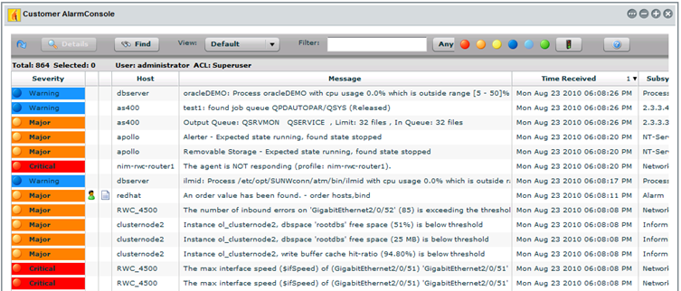
Unified Portal: Alarm Console
See, assign, and close alarms. Fast.
When a problem strikes, Nimsoft helps global teams work together to accelerate resolution
event correlation
assignment
acknowledgement

Slide 75
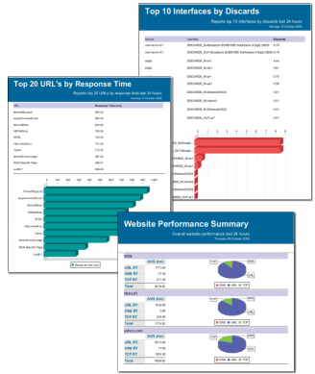
Unified Reporter
Business insights via intelligent analytics
~120 pre-packaged reports and fast, drag-and-drop custom report creation
Report based on geographies, users, and groups
Output reports in HTML, PDF, XLS, RTF, SWF, ODF, and TXT
Flexible report scheduling, distribution and historical versioning

Slide 76
Functional Benefits of Unified IT Management
Bi-directional alarm and ticket integration
Alarms can automatically create tickets based on business rules
Tickets can be created directly from alarms
Information updated in both alarm and ticket as work progresses
Automated workflow kicked off based on business rules
Customer based – Service level entitlements
Asset based – Prioritization based on asset class
Unified customer experience
Customer goes to one place for performance data, ticket information & service requests
One single solution to integrate into consolidated customer portal
Centralized reporting
Consistent tool for operators and agents
Consolidate applications for internal users streamlining response
Role based access to information and functionality

Slide 77
Administrative Benefits of Unified IT Management
Scalability & Integrations
Message bus is a highly scalable architecture (functional and practical)
No integrations to manage between SD and Monitoring
API driven integration with billing and customer portal (CIAC & MetraNet)
Centralized Administration
Administer all customer facing data through one tool
Single sign on (internal/external)
Centralized administration for Monitoring & SD
Reduction in HW required to support solution
Centralized reporting
Upgrade Process Simplified
Standard upgrade process reduces impact on critical systems
Significantly less effort to manage upgrade process

Slide 78
Process Benefits of Unified IT Management
Service Improvement
Proactive resolution of incidents through automated workflow
Operators more efficient
Consistent customer experience
Operators have accurate up to date information
Automated workflow ensures consistent experience
Reduced Cost of Service
Less manual intervention between Ops and Service Desk
Reduced administration/management effort
Less risk of duplication of effort
TCO reduced through the elimination of multiple tools
Single integration point to other workflow tools
Message bus “future proofs” investment as requirements grow
Automated workflow streamlines process
Multi-tenancy simplifies multi-customer service

Slide 79

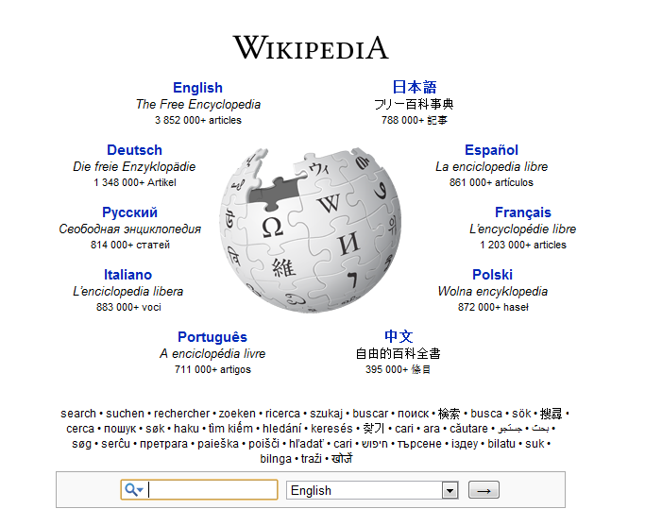
Customer Case Study
Wikimedia. 470,000,000
Visitors, and Counting.
Nimsoft Watchmouse helps Wikimedia provide a great user experience for hundreds of millions of users and contributors around the globe.
Read More
READ MORE CASE STUDIES HERE!
Notes:
The Wikimedia Foundation operates some of the largest collaboratively edited reference projects in the world, including Wikipedia, a top-ten Internet property.
Challenge
Needed to easily track and report on service availability and end user experience
Needed to isolate and fix issues
Wanted to more effectively communicate status to user community
Solution
Watchmouse User Experience monitoring from 60 locations in 30 countries
Capabilities for providing automated reporting of web any service performance status
Results: Transformed IT
Provides visibility needed to enhance the end user experience for site visitors and contributors.
Improves site transparency to build credibility and foster good will within the user community.
Enables proactive problem mitigation, reducing downtime and enabling cost and time efficiencies.
Improves service levels for users, editors and developers by increasing access to information.

Slide 80
Thank you
Q&A
Socialize with us:

